Slide 1
CYBER GYAN VIRTUAL INTERNSHIP PROGRAM Centre for Development of Advanced Computing (CDAC), Noida
Submitted By:
Vishal Kumar
Project Trainee, (July-August) 2025

Slide 2




TOPIC NAME
Exploring Tools and Websites for Detecting Fake News, Fake Emails, Fake WhatsApp Messages, and Fake Social Media Posts.

Slide 3
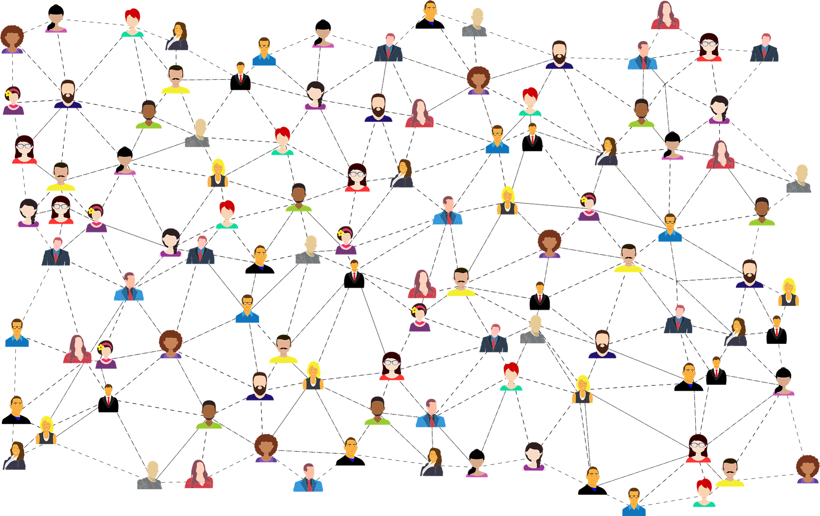
PROBLEM STATEMENT
In today’s digital era, we are witnessing an unprecedented surge in the creation and spread of false information, marking what experts call "The Misinformation Age".
This project operates within the domain of Digital Media Verification and Misinformation Detection.
It addresses the challenge by investigating various tools and websites designed to detect and combat the spread of misinformation across multiple online platforms.
The problem is multi-faceted, requiring specific focus on researching and evaluating tools tailored to identifying:
Fake news articles
Fake emails
Fake WhatsApp messages
Fake social media posts
A major challenge is the difficulty in assessing the reliability and effectiveness of potential solutions.
This project aims to test selected tools for their effectiveness in detecting and verifying the authenticity of digital content.
The goal is to produce a comprehensive review and comparison of tools, providing a curated list of recommended solutions with their features and functionalities.

Slide 4
TECHNOLOGY/TOOLS TO BE USED
Traditional Fact-Checking & Verification Tools :
FactCheck.org, Snopes, PolitiFact, Check Your Fact – Established platforms for verifying news articles and claims.
AI-Powered Fact-Checking & Verification Assistants :
Grok (xAI) – Use on X (formerly Twitter): reply with “@grok Is this true?” to receive real-time responses backed by credible sources.
Perplexity AI – It’s an AI-based search/chatbot that cites sources which is useful for social media verification and "hoax tracing."
Facticity.AI (AI Seer) – Offers ≈ 92 % accuracy in fact-checking text and video claims; extensions for Word and Chrome coming soon.
Originality.AI – Checks for factual accuracy, plus plagiarism and AI-generated content detection.
ClaimBuster – AI tool to detect factual claims in text and evaluate them automatically.
Browser Extensions & Image Verification Tools :
NewsGuard – Browser plug-in that rates news websites with a credibility "nutrition label."
Fake News Debunker (InVID-WeVerify) – It Offers YouTube/Facebook video provenance, metadata extraction, reverse image search, and a known‐fake database.
SurfSafe – It is a Chrome/Opera extension that flags potentially manipulated images.
Google Fact Check Explorer – It is Search engine that searches claims using keywords or quotes; returns fact-check results with ratings.

Slide 5
TECHNOLOGY/TOOLS TO BE USED
Reverse Image & Deepfake Detection Tools
Google Reverse Image Search, TinEye, RevEye – Trace the origin and earliest iterations of images to verify authenticity.
Sentinel, Intel FakeCatcher, Microsoft Video AI Authenticator, Phoneme-Viseme Mismatch Tool – These are advanced AI tools that analyze video for manipulation, facial inconsistencies, lip-sync mismatches, and subtle visual artifacts.
Vastav AI – India’s cloud-based deepfake detection tool, analysing videos, images, and audio using metadata and ML models with high accuracy.
Social Media & Disinformation Campaign Analysis Platforms
Hoaxy – Visualizes how misinformation and fact-checks spread across social media.
Cyabra – AI-driven platform that detects fake profiles, coordinated disinformation, and generative AI content across languages in real time.
Graphika – Tracks and maps disinformation campaigns and networks across social media platforms.
Settings and Applications
Emails / Spoofed Content → Use Originality.AI and ClaimBuster for text verification.
WhatsApp Messages → Use IFCN/AFP Fact-Check chatbot and MCA Deepfake Helpline to verify and fact-check suspicious texts, images, videos, and audio, helping detect misinformation and AI-generated deepfakes in real time.
Deepfakes / Manipulated Media → Use tools such as Sensity AI, Vastav AI, FakeCatcher, Sentinel.

Slide 6
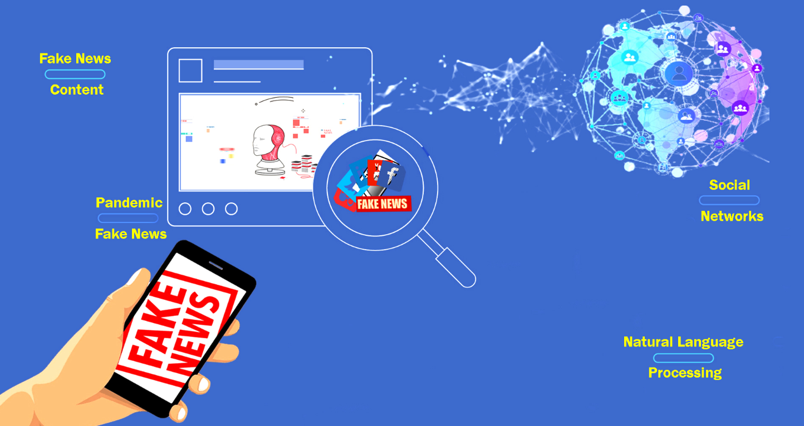
ABOUT THE ATTACK/TOPIC/PROBLEM STATEMENT
Nature of the Threat :
The rapid spread of misinformation and disinformation is a significant cyber and social threat in the digital age.
Threat actors exploit digital platforms to manipulate public opinion, conduct fraud, or cause social unrest.
Attack Vectors :
Fake News Articles – Fabricated stories presented as legitimate journalism, often for political or financial gain.
Fake Emails (Phishing) – Deceptive emails designed to steal sensitive data or spread malware.
Fake WhatsApp Messages – Forwarded hoaxes, deepfakes, or scams that gain credibility in closed groups.
Fake Social Media Posts – Manipulated text, images, or videos on platforms to mislead or influence audiences.
Why It’s a Cybersecurity Concern :
Can facilitate social engineering, phishing attacks, and mass manipulation campaigns.
Uses AI-generated content (deepfakes, synthetic media) to make fakes more convincing.
Undermines trust in authentic communication channels.
Core Challenge :
Manual verification is slow and insufficient.
Requires automated, scalable, and multi-platform detection solutions to keep pace with the volume of fake content.

Slide 7
THE REASONS BEHIND THE PROBLEM/ATTACKS ARE
The spread of fake content is the result of intertwined technical, psychological, and systemic drivers that adversaries exploit for maximum impact. Some of the key reasons include :
1) Unregulated Proliferation of User-Generated Content
The democratization of publishing via social media, microblogging platforms, and encrypted messaging services enables instantaneous global dissemination of unverified information.
Absence of mandatory pre-publication content vetting results in an environment where misinformation can propagate unchecked.
2) Deficiency in Digital Information Literacy
A significant portion of end-users lack the critical thinking skills and media literacy required to differentiate between credible and fabricated content.
This vulnerability is exploited by malicious actors through social engineering campaigns.
3) Financially and Politically Motivated Disinformation Operations
Ad-based revenue models incentivize clickbait and sensational content, irrespective of factual accuracy.
State-sponsored information warfare and politically aligned groups deploy coordinated inauthentic behavior (CIB) networks to manipulate public perception and influence electoral processes.

Slide 8
THE REASONS BEHIND THE PROBLEM/ATTACKS ARE
4) Psychological and Cognitive Bias Exploitation
Disinformation leverages confirmation bias, availability heuristics, and emotional triggers to increase virality.
High-arousal content (fear, outrage, pride) is algorithmically rewarded, leading to rapid audience engagement and re-sharing.
5) Advanced Generative AI and Deepfake Capabilities
The advent of sophisticated AI models enables creation of hyper-realistic synthetic media text, audio, images, and videos indistinguishable from authentic sources without advanced forensic analysis.
Automated botnets and AI-assisted content farms scale disinformation production at unprecedented rates.
6) Regulatory and Policy Gaps
Lack of standardized international cyber legislation addressing misinformation and AI-generated content creates jurisdictional loopholes.
Platform-level content moderation is often reactive rather than proactive due to operational and legal constraints.
7) Algorithmic Amplification and Filter Bubbles
Machine learning recommendation systems optimize for engagement, inadvertently prioritizing sensationalized or false content over verified information.
Personalized feeds create echo chambers, reinforcing pre-existing beliefs and insulating users from counter-narratives.
8) Encryption and Platform Architecture Challenges
End-to-end encryption on platforms like WhatsApp and Signal prevents external auditing of shared content, complicating misinformation detection and takedown efforts. Decentralized platforms and peer-to-peer networks further obscure traceability of malicious content origin.

Slide 9
SOME POSSIBLE SOLUTIONS/COUNTERMEASURES
Mitigating the spread of misinformation requires a multi-layered strategy that integrates advanced cybersecurity techniques, ethical hacking methodologies, and state-of-the-art data protection tools, supported by robust user education and policy enforcement.
1. AI-Powered Misinformation Detection Systems
Deploy machine learning and NLP models (e.g., BERT, GPT-based classifiers) to detect linguistic patterns, sentiment anomalies, and semantic inconsistencies in suspected fake content.
Use deepfake detection algorithms (e.g., Microsoft Video Authenticator, Intel FakeCatcher, Sensity AI) to identify manipulated media in near real-time.
2. Ethical Hacking for Threat Intelligence
Red Team Operations: Ethical hackers simulate misinformation campaigns to test platform resilience and identify vulnerabilities in content moderation systems.
OSINT (Open Source Intelligence): Use advanced reconnaissance tools (e.g., Maltego, Recon-ng) to trace the origin and propagation networks of fake content.
Dark Web Monitoring: Ethical hackers can infiltrate underground forums where misinformation campaigns are planned, allowing pre-emptive countermeasures.
3. Blockchain-Based Content Authentication
Implement Content Provenance Systems (e.g., Adobe Content Authenticity Initiative, Truepic) to cryptographically sign and verify the origin of images, videos, and documents.
Blockchain ledgers ensure tamper-proof tracking of a file’s creation and modification history.

Slide 10
SOME POSSIBLE SOLUTIONS/COUNTERMEASURES
4. Advanced Email & Messaging Security
Use DMARC, DKIM, and SPF for email authentication to prevent spoofing.
Integrate phishing simulation platforms (e.g., KnowBe4, Cofense) for organizational training.
Deploy end-to-end encryption with metadata analysis capabilities to detect malicious attachments or links in encrypted traffic without violating privacy.
5. Multi-Layered Data Protection
Zero Trust Architecture (ZTA): Never trust, always verify; applies strict access controls and continuous authentication.
Data Loss Prevention (DLP): Tools like Symantec DLP or Forcepoint monitor and block sensitive data leaks.
Homomorphic Encryption: Allows computations on encrypted data, protecting privacy while enabling content analysis.
6. Policy, Regulation, and User Awareness
Collaborate with regulators to develop AI-specific misinformation laws.
Mandate digital media literacy programs in schools and workplaces.
Encourage crowdsourced fact-checking communities (e.g., Wikipedia’s edit moderation, Twitter/X Community Notes).

Slide 11
REFERENCES & RESOURCES
📚 References :
Snopes
PolitiFact
urlscan.io
Google Fact Check Explorer
InVID Plugin
🛠️Resources :
The Misinformation Age – Cailin O’Connor & James Weatherall
Verification Handbook – Craig Silverman
The Anatomy of Fake News – Nolan Higdon

Slide 12
THANKYOU

